Slide 1
Spinetoram Large Scale Collaborative Study by Corteva Agrisciences and Clarke International LLC
Jennifer Jones Corteva Agrisciences
9330 Zionsville Rd
Indianapolis, Indiana USA

Slide 2
CIPAC Large Scale Collaborative Trial - Spinetoram
Large scale trial for Spinetoram (CIPAC number 5250/R)
Analysis of four formulation types:
Technical Material (TC)
Suspension Concentrate (SC)
Water dispersible (WG)
Direct application to water (DT)
Procedure utilized – CIPAC Guidelines for Collaborative Study Procedures for Assessment of Performance of Analytical Methods

Slide 3
Spinetoram – CIPAC Method Description
Outline of proposed CIPAC Method for Spinetoram (CIPAC number 5249/m)
Spinetoram is determined by reversed phase high performance liquid chromatography (HPLC) using UV detection at 250nm with external standardization.
Spinetoram standard is dispersed in water, followed by dissolution using mechanical shaking after the addition of methanol.

Slide 4
Spinetoram – TC, SC, WG, and DT Overview
Outline of TC preparation
Spinetoram TC is dispersed in water, then shaken after the addition of methanol, until completely dissolved. Filtering is not necessary.
Outline of SC, WG, and DT Preparation
Formulated product is dispersed in water, then shaken after the addition of methanol. The final sample solution is filtered through a 0.45µ nylon filter, discarding the first few milliliters.

Slide 5
Spinetoram – HPLC conditions – CIPAC Method
Parameter | Specification
Column Temperature | 30°C
Column | Phenomenex Luna C8(2) 3µ 150x4.6mm or equivalent
Flow rate | 1.0 mL/min
Wavelength | 250 nm
Injection Volume | 10 µL
Run Time | ~20 min.
Retention Time | Spinetoram-J: ~10-12 min Spinetoram-L: ~12-15min

Slide 6
Large Scale Trial Setup
18 laboratories volunteered – 11 labs successfully received materials and sent back results by due date.
Materials shipped:
Standard
2 batches of TC
2 batches of SC
1 batch of WG
1 batch of DT

Slide 7
Individual laboratory results (wt%)
Lab | TC1 | TC2 | SC1 | SC2 | WG | DT
1 | 88.1 | 88.8 | 12.0 | 14.0* | 24.3 | 1.02
2 | 89.7 | 90.0 | 12.0 | 12.7 | 24.3 | 0.986
3 | 94.2 | 92.6 | 12.2 | 12.9 | 25.0 | 0.961
4 | 89.6 | 88.6 | 11.7 | 12.7 | 24.0 | 0.961
5 | 91.2 | 91.0 | 11.6 | 12.5 | 24.4 | 0.866
6 | 89.0 | 88.6 | 11.7 | 12.7 | 24.0 | 0.961
7 | 89.9 | 87.4 | 11.9 | 12.6 | 24.7 | 0.985
8 | 89.9 | 90.5 | 12.1 | 12.7 | 24.2 | 0.859
9 | 90.1 | 90.6 | 12.2 | 13.1 | 24.7 | 1.01
10 | 90.5 | 91.1 | 12.3 | 13.2 | 24.7 | 0.988
11 | 85.6 | 85.8 | 12.0 | 12.5 | 25.2 | 0.271*
%RSD | 2.32 | 2.17 | 1.88 | 1.90 | 1.54 | 5.67
*Outliers

Slide 8
Statistical Analysis – Outliers per Grubb’s Test
Formulation | Minimum Result |  | Maximum Result
 | Value (wt%) | Lab | Value (wt%) | Lab
SC2 | 12.45 | 5 | 13.95 | 1
DT | 0.27 | 11 | 1.02 | 1
Upper 1% | 2.485 | Upper 5% | 2.234
 | SC2 | DT
Lowest Value | 12.5 | 0.27
Grubbs Statistic | 0.974 | 2.926*
Highest Value | 13.95 | 1.02
Grubbs Statistic | 2.539* | 0.556
*Outliers

Slide 9
Analysis of Outliers
%RSD, repeatability, reproducibility, and any other relevant calculations were performed with the omission of any data considered an outlier.

Slide 10
Repeatability (% w/w)
Sample | S_{r} (Repeatability standard deviation) | r (repeatability) | Average r
TC1 | 1.18 | 3.29 | 4.76
TC2 | 2.22 | 6.23
SC1 | 0.283 | 0.791 | 0.735
SC2 | 0.271 | 0.680
WG | 0.322 | 0.903 | -
DT | 0.077 | 0.212 | -

Slide 11
Reproducibility (% w/w)
Sample | S_{R} (Reproducibility standard deviation) | R (Reproducibility) | Average R
TC1 | 2.36 | 6.60 | 7.28
TC2 | 2.84 | 7.96
SC1 | 0.347 | 0.971 | 0.95
SC2 | 0.497 | 0.931
WG | 0.483 | 1.35 | -
DT | 0.226 | 0.250 | -

Slide 12
Statistical summary
Statistical variable | TC1 | TC2 | SC1 | SC2 | WG | DT
X | 89.8 | 89.5 | 12.0 | 12.8 | 24.5 | 0.959
L | 11 | 11 | 11 | 10 | 11 | 10
S_{r} | 1.18 | 2.22 | 0.283 | 0.243 | 0.322 | 0.076
S_{L} | 2.04 | 1.77 | 0.201 | 0.227 | 0.360 | 0.047
S_{R} | 2.36 | 2.84 | 0.347 | 0.333 | 0.483 | 0.089
RSD_{r} | 1.31 | 2.48 | 2.36 | 1.90 | 1.32 | 7.90
RSD_{R} | 2.63 | 3.18 | 2.90 | 2.61 | 1.97 | 9.31
r | 3.29 | 6.23 | 0.791 | 0.680 | 0.903 | 0.212
R | 6.60 | 7.96 | 0.971 | 0.931 | 1.35 | 0.25
RSD_{R}(Hor) | 2.03 | 2.03 | 2.75 | 2.73 | 2.47 | 4.03

Slide 13
Application of the Horwitz Ratio
%RSD = 2^{(1-0.5*log(C))} C = concentration of analyte expressed as a decimal, utilizing the average concentration from the results.
Sample | TC1 | TC2 | SC1 | SC2 | WG | DT
%RSD | 2.32 | 2.17 | 1.88 | 1.90 | 1.54 | 5.67
%RSD Horwitz equation | 2.03 | 2.03 | 2.75 | 2.73 | 2.47 | 4.03
Horwitz Ratio | 1.1 | 1.1 | 0.7 | 0.7 | 0.6 | 1.4
Horwitz Ratio Range | Acceptability
0.3 < Ratio < 1 | Acceptable
Ratio < 0.3 or 1 < Ratio < 2 | Acceptable but may require explanation
Ratio > 2 | Not acceptable

Slide 14
Overall Result Summary
Sample | Overall Average | Repeatability | Reproducibility
TC1 | 89.8 wt% (898 g/kg) | 4.76 | 7.28
TC2 | 89.5 wt% (895 g/kg)
SC1 | 12.0 wt% | 0.735 | 0.95
SC2 | 12.8 wt%
WG | 24.5 wt% (245 g/kg) | 0.903 | 1.35
DT | 0.959 wt% (9.6 g/kg) | 0.212 | 0.250
Application of the Horwitz equation and ratio to the data set for the TC, SC, and WG shows results as “acceptable”. For the DT formulation, it did result in slightly higher than the “acceptable” range, but well below the “not acceptable” range, and this is due to the lower loading of concentration in the formulation; results were 1.0 – 0.9 wt%. Results were within the “acceptable but may require explanation” range and are well within the specification of the formulated product.

Slide 15
Comments, deviations and observations from participating laboratories
Lab | Deviations
1 | Different column was used: ZORBAX SB-C8 4.6x150mm 3.5μm
2 | None
3 | Different column was used: Gemini NX – C18 3µm, 100 x 4.6 mm
4 | Different column was used: Phenomenex Luna 3um C18(2) 100x3mm
5 | None
6 | Different column was used: Phenomenex Luna 3um C18(2) 100x3mm
7 | None
8 | None
9 | Different column was used: Phemonenex Kinetex CoreShell-C18 150x4.6mm 5um
10 | None
11 | Slightly different column used: phenomenex luna C8 5u 150x4,6mm

Slide 16
Study summary and next steps
TC repeatability and reproducibility were 47.6 g/kg and 72.8 g/kg, respectively. The Horwitz ratio was just above the 1 acceptable ratio, with a result of 1.1. This is still within the acceptable range, as this slightly higher ratio may be due to it being a mixture of 2 main factors and a technical process which involves a biological fermentation step.
SC repeatability and reproducibility was 7.35 g/kg and 9.5 g/kg, respectively. Horwitz ratio was within the “acceptable” ratio for each batch.
WG repeatability and reproducibility was 9.03 g/kg and 13.5 g/kg, respectively. Horwitz ratio was within the “acceptable” ratio for each batch.
DT repeatability and reproducibility was 2.12 g/kg and 2.5 g/kg respectively. The Horwitz ratio was above the normal fully acceptable ratio, with a result of 1.4. This is still within the acceptable range, as this slightly higher ratio may be due to its low a.i. concentration. In addition, the overall results range was 0.9 – 1.0, which is well within the specification for this formulation type.
Different column types were used across many labs, with no major impact of the results, but that the Luna C(8) column should be used for final method.
Based on the data generated, we deem the method robust, repeatable and reproducible and would recommend that this method is accepted as provisional by CIPAC.

Slide 17
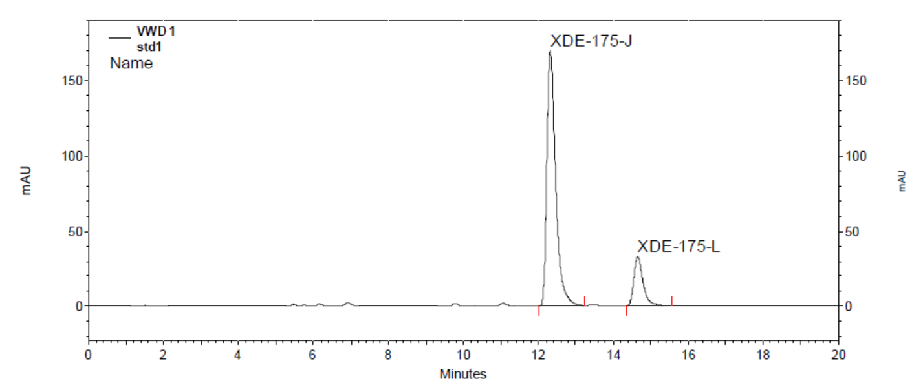
Example Standard Chromatogram

Slide 18
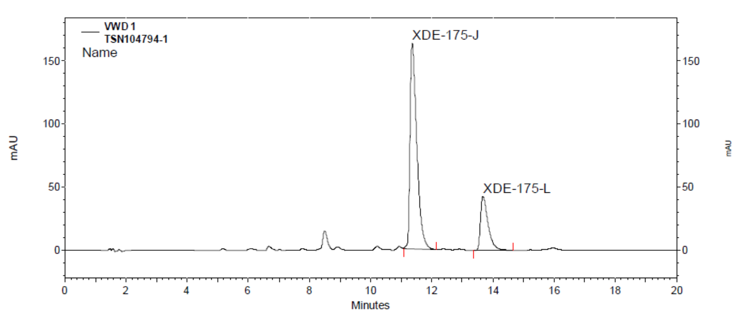
Example TC chromatogram

Slide 19
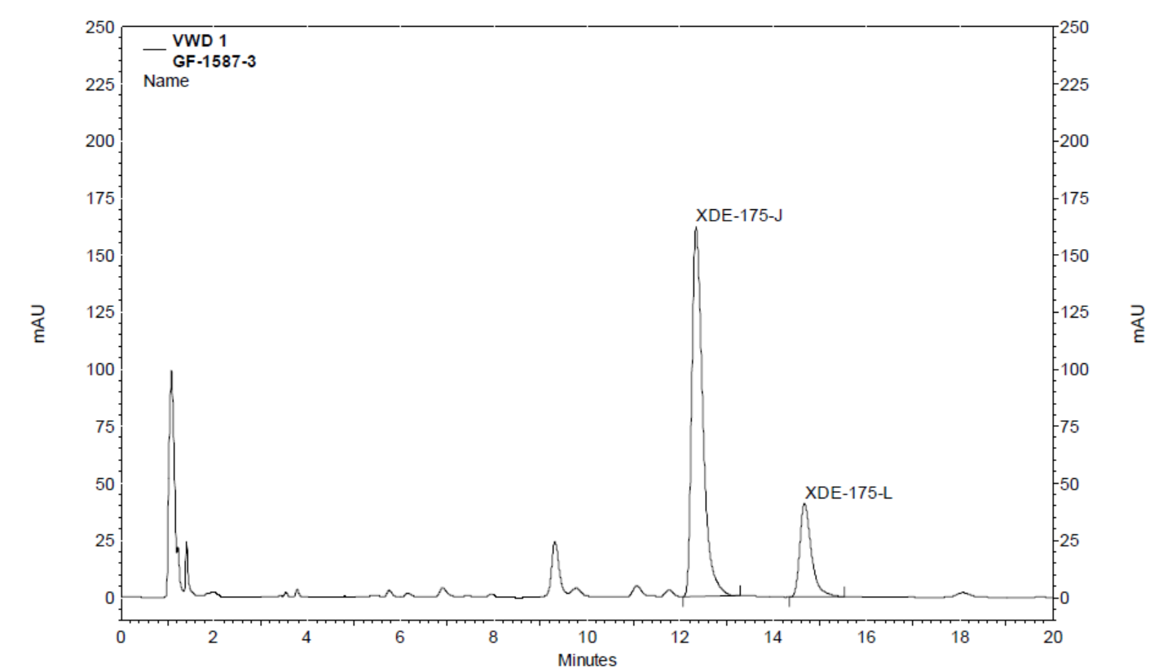
Example SC chromatogram

Slide 20
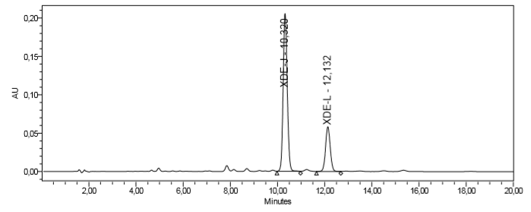
Example WG chromatogram

Slide 21
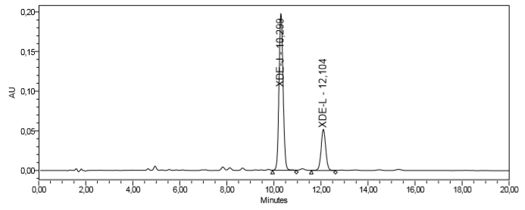
Example DT chromatogram

